Slide 1
What is a Web Map?
Digital Map that works in the browser
Web map v/s web app
Google Maps, Mapbox, CartoDB, ESRI

Slide 2
Technological Changes
Web Services
Open Data
Open Data Standards and Formats
Free and Open Source Software

Slide 3
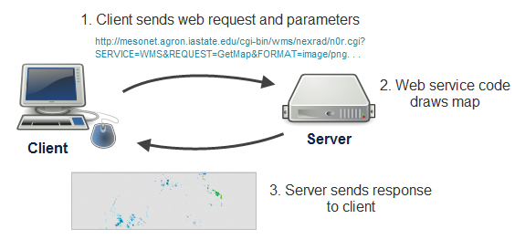
Web Services
A focused task that a specialized computer (the server) knows how to do and allows other computers to invoke.
Notes:
All the above web mapping scenarios are possible because of web services. If you search the Internet, you'll find many definitions of web services and can easily get yourself confused. For the purposes of this course, just think of a web service as a focused task that a specialized computer (the server) knows how to do and allows other computers to invoke. You work with the web service like this:
You invoke the web service by making a request from an application (the client). To make this request you use HTTP, the standard protocol that web browsers use for communicating between clients and servers. The request contains structured pieces of information called parameters. These give specific instructions about how the task should be executed.
The server reads the request and runs its web service code, considering all the parameters while doing so. This produces a response, which is usually a string of information or an image.
The server sends you the response, and your application uses it.

Slide 4
Web Services (contd.)
APIs (Application Programming Interface )
Basemaps, Data, Geocoding, Navigation, Spatial Analysis
Commercial Providers
Google, Mapbox, CartoDB, ESRI, MapZen … many more
Free and paid plans
Non-commercial Providers
Data.gov, SF Open Data, NPMap, OSM
Cal-Adapt, Ecoengine, Landcarbon

Slide 5
Open Data
Free, limited or no copyright restrictions
Government, researchers, non-profits, citizen contributions
Precautions
Attribution requirements
Restrictions on redistributing
Data quality

Slide 6
Open Data Standards & Formats
Open data formats
KML, GeoJSON, Shapefile, NetCDF, JPEG, PNG
Closed data formats
ESRI file geodatabase
Open Specifications for services
Open Geospatial Consortium (OGC)
Web Map Service, Web Feature Service, Web Map Tile Service

Slide 7
Free and Open Source Software
Desktop
QGIS, GRASS GIS
Geo-enabled databases
PostgreSQL/PostGIS, SpatialLite, MySQL
Exposing spatial data to the web
MapServer, QGIS Server, GeoServer, Mapnik, TileCache, TileStache
JavaScript Mapping Libraries and APIs
System libraries
GDAL, OGR, PROJ4

Slide 8
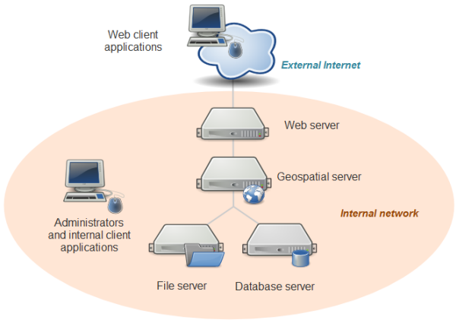
System Architecture for Web Mapping

Slide 9
Some Design Considerations for Web Mapping
Who's your target audience?
What's the story?
How much data to you have? Where is it?
Is the web map going to part of an existing website?
Do you need to support tablets and mobiles?
Do you need to support offline access?

Slide 10
Share Your Data – So Others Can Build On It
Upload it to ArcGIS Online, CartoDB, MapBox. Make data available as a feature service.
Upload it to GitHub. Supports geojson and topojson formats. Version control, collaboration tools.
Contribute to OSM

Slide 11
Publish Interactive Maps – No Coding
Use ESRI, CartoDB, MapBox platforms to store data, design and publish web maps and web apps.
Create your map in QGIS. Use plugins to convert map to code that you host. Or use QGIS Cloud to publish web maps
Google Fusion Tables

Slide 12
Publish Interactive Maps – Some Coding
ESRI, CartoDB, MapBox provide JavaScript libraries to create custom web maps and API's to interact with data hosted on their platforms
Use other open source JS libraries, e.g. Leaflet, D3 to build your web map or data viz
Technology – JavaScript/HTML/CSS, Web Server

Slide 13
ESRI Platform
ArcGIS Online
Share data as Feature Services
Make and share Web Maps
ArcGIS For Developers
StoryMaps
HTML/JS Web Applications with ready-to-use widgets (WebAppBuilder)
HTML/JS Web Applications with templates (Configurable Apps)
Mobile and Native Applications
ArcGIS REST APIs
Geocoding, Routing, GeoEnrichment, Feature Services, Map Services, Spatial Analysis, Elevation Analysis, Data Management
ArcGIS API for Javascript
ESRI Leaflet
ArcGIS Server with ArcSDE

Slide 14
MapBox Platform
Mapbox Studio
Manage spatial data, create custom web tiles
Mapbox Editor
In browser editor for creating simple web maps
APIs - Geocoding, Directions, Uploads, Distance, Styles, Surface, etc.
Mapbox JS (built on Leaflet, use with image tiles)
Mapbox GL JS (use with vector tiles)
Amazon Cloud Infrastructure for storing and serving vector and image map tiles

Slide 15
CartoDB Platform
CartoDB Editor
CartoDB.js
Built with Leaflet, Torque, Windshaft, Mapnik, etc.
SQL API
Import API
PostgreSQL/PostGIS
Leaflet - Lightweight JavaScript Mapping Library
Torque - Render big, timeseries data in the client. Uses CartoDB to generate a datacube format.
Windshaft - A Node.js map tile library for PostGIS and torque.js, with CartoCSS styling
Mapnik - C++ library for reading geospatial data and rendering maps (can be scripted with JS and Python)

Slide 16
Publish Interactive Maps – Lot More Coding
Host your own data and publish data services and/or web maps through your rendering infrastructure
One click install of complete open source stack (PostGIS, GeoServer, GeoWebCache, OpenLayers, QGIS plugin)
Build your own stack

Slide 17
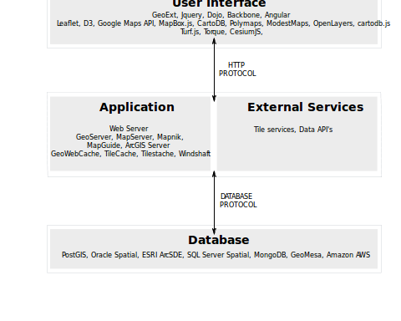
Build your own stack

Slide 18
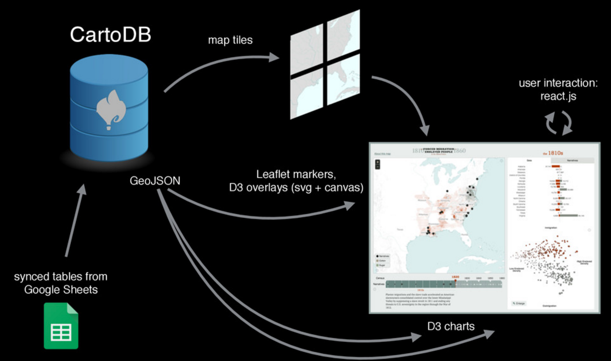

Slide 19
Publish Mobile Apps
ESRI AppStudio
AmigoCloud, FUlcrum
Mobile SDKs (software development kit) from ESRI, CartoDB, MapBox, others

Slide 20
Web Mapping at the GIF

Slide 21
GIF Projects
LandCarbon
Holos – Berkeley Ecoinformatics Engine
Cal-Adapt

Slide 22
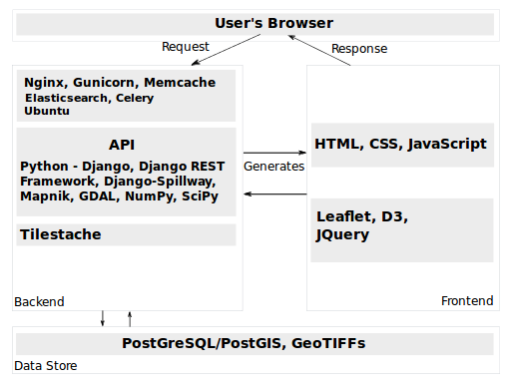
GIF
Web
Mapping
Stack

Slide 23
Some Considerations for Choosing your Web Mapping Stack
Project requirements – short-term prototyping vs. long-term development
Availability of previous experience or expertise within team
Vendor lock-in effects
Cost/licensing
Ongoing support and maintenance

